Slide 1
Probabilistic Topic Models for
Web Mining
Dr. A Bhuvaneswari
SCOPE VIT

Slide 2
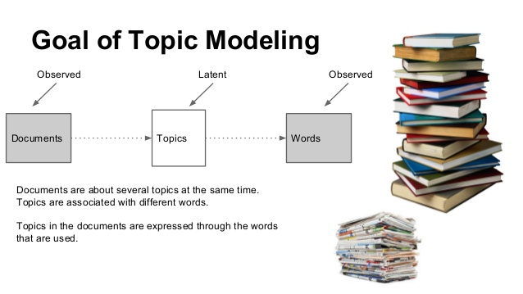


Slide 3
Motivating Example:
Comparing Product Reviews
IBM Laptop
Reviews
APPLE Laptop
Reviews
DELL Laptop
Reviews
Common Themes | “IBM” specific | “APPLE” specific | “DELL” specific
Battery Life | Long, 4-3 hrs | Medium, 3-2 hrs | Short, 2-1 hrs
Hard disk | Large, 80-100 GB | Small, 5-10 GB | Medium, 20-50 GB
Speed | Slow, 100-200 Mhz | Very Fast, 3-4 Ghz | Moderate, 1-2 Ghz
Unsupervised discovery of common topics and their variations

Slide 4
Motivating Example:
Comparing News about Similar Topics
Vietnam War
Afghan War
Iraq War
Common Themes | “Vietnam” specific | “Afghan” specific | “Iraq” specific
United nations | … | … | …
Death of people | … | … | …
… | … | … | …
Unsupervised discovery of common topics and their variations

Slide 5
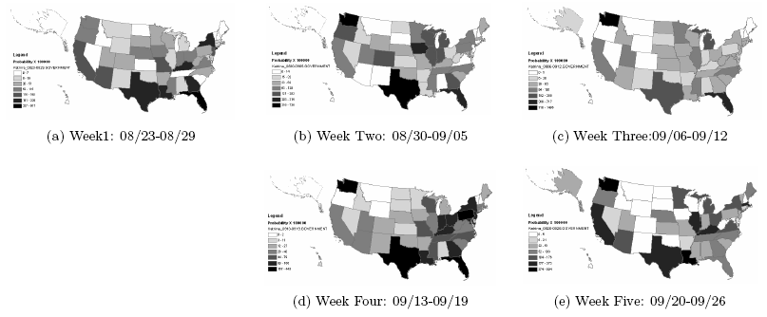
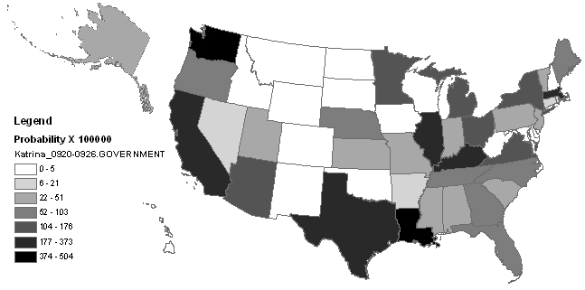
Motivating Example:
Analyzing Spatial Topic Patterns
How do blog writers in different states respond to topics such as “oil price increase during Hurricane Karina”?
Unsupervised discovery of topics and their variations in different locations

Slide 6
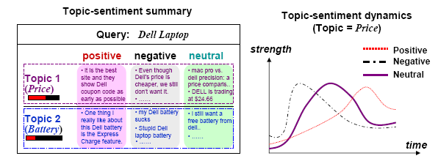
Motivating Example:
Sentiment Summary
Unsupervised/Semi-supervised discovery of topics and
different sentiments of the topics

Slide 7
Two Different Views of Web Mining
Data Mining View: Explore patterns in textual data
  Find latent topics
  Find topical trends
  Find outliers and other hidden patterns
Natural Language Processing View: Make inferences based on partial understanding natural language text
  Information extraction
  Question answering
Shallow mining
Deep mining

Slide 8
Applications of Text Mining
Direct applications: Go beyond search to find knowledge
  Question-driven (Bioinformatics, Business Intelligence, etc): We have specific questions; how can we exploit data mining to answer the questions?
  Data-driven (WWW, literature, email, customer reviews, etc): We have a lot of data; what can we do with it?
Indirect applications
  Assist information access (e.g., discover latent topics to better summarize search results)
  Assist information organization (e.g., discover hidden structures)

Slide 9
Basic Topic Model: PLSA
Probabilistic Latent Semantic Analysis/Indexing (PLSA/PLSI)

Slide 10
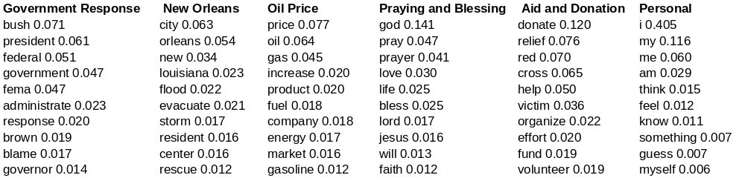
PLSA: Motivation
What did people say in their blog articles about “Hurricane Katrina”?
Query = “Hurricane Katrina”
Results:

Slide 11
Probabilistic Latent Semantic Analysis/Indexing (PLSA/PLSI) [Hofmann 99]
Mix k multinomial distributions to generate a document
Each document has a potentially different set of mixing weights which captures the topic coverage
When generating words in a document, each word may be generated using a DIFFERENT multinomial distribution
We may add a background distribution to “attract” background words

Slide 12
Topic Modeling with Latent Dirichlet Allocation (LDA)

Slide 13
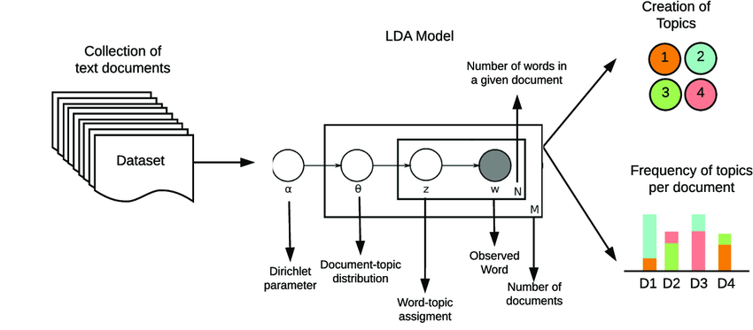
LDA PLATE NOTATION

Slide 14
PLSA as a Mixture Model
Document d
warning 0.3 system 0.2..
?
Topic θ₁
?
π_{d,1}
θ₁
“Generating” word w
in doc d in the collection
aid 0.1
donation 0.05
support 0.02 ..
θ₂
Topic θ₂
?
?
π_{d,2}
1 - λ_{B}
?
π_{d, k}
W
…
θ_{k}
statistics 0.2
loss 0.1
dead 0.05 ..
?
?
λ_{B}
Topic θ_{k}
?
B
is 0.05
the 0.04
a 0.03 ..
?
Background B
?
Parameters:
λ_{B}=noise-level (manually set)
θ’s and π’s are estimated with Maximum Likelihood
?

Slide 15
How to Estimate θ_{j}: EM Algorithm
the 0.2
a 0.1
we 0.01
to 0.02
…
Known
Background
p(w | B)
Observed Doc(s)
Unknown
topic model
p(w|θ₁)=?
“Text mining”
…
text =?
mining =?
association =?
word =?
…
Suppose,
we know
the identity
of each
word ...
ML
Estimator
…
Unknown
topic model
p(w|θ₂)=?
“information
retrieval”
…
information =?
retrieval =?
query =?
document =?
…

Slide 16
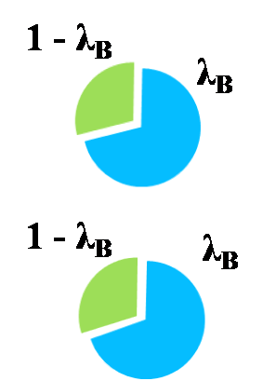
How the Algorithm Works
c(w,d)(1 - p(z_{d,w} = B))p(z_{d,w}=j)
c(w,d)p(z_{d,w} = B)
π_{d1,1}
( P(θ₁|d₁) )
π_{d1,2}
( P(θ₂|d₁) )
c(w, d)
aid
7
d₁
price
5
Initial value
6
oil
π_{d2,1}
( P(θ₁|d₂) )
π_{d2,2}
( P(θ₂|d₂) )
aid
8
d₂
price
7
oil
5
Initial value
P(w| θ)
Topic 1
Topic 2
Initializing π_{d, j} and P(w| θ_{j}) with random values
Iteration 1: E Step: split word counts with different topics (by computing z’ s)
Iteration 1: M Step: re-estimate π_{d, j} and P(w| θ_{j}) by adding and normalizing the splitted word counts
Iteration 2: E Step: split word counts with different topics (by computing z’ s)
Iteration 2: M Step: re-estimate π_{d, j} and P(w| θ_{j}) by adding and normalizing the splitted word counts
Iteration 3, 4, 5, …
Until converging
aid
price
Initial value
oil

Slide 17
PLSA with Prior Knowledge
There are different ways of choosing aspects (topics)
  Google = Google News + Google Map + Google scholar, …
  Google = Google US + Google France + Google China, …
Users have some domain knowledge in mind, e.g.,
  We expect to see “retrieval models” as a topic in IR.
  We want to show the aspects of “history” and “statistics” for Youtube
A flexible way to incorporate such knowledge as priors of PLSA model
In Bayesian, it’s your “belief” on the topic distributions

Slide 18
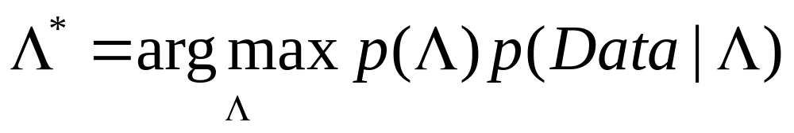
Adding Prior
Most likely Λ
Document d
warning 0.3 system 0.2..
Topic θ₁
π_{d,1}
θ₁
“Generating” word w
in doc d in the collection
aid 0.1
donation 0.05
support 0.02 ..
θ₂
Topic θ₂
π_{d,2}
1 - λ_{B}
π_{d, k}
W
…
θ_{k}
statistics 0.2
loss 0.1
dead 0.05 ..
λ_{B}
Topic θ_{k}
B
is 0.05
the 0.04
a 0.03 ..
Background B
Parameters:
λ_{B}=noise-level (manually set)
θ’s and π’s are estimated with Maximum Likelihood

Slide 19
Adding Prior as Pseudo Counts
Observed Doc(s)
the 0.2
a 0.1
we 0.01
to 0.02
…
Known
Background
p(w | B)
MAP
Estimator
Unknown
topic model
p(w|θ₁)=?
“Text mining”
…
text =?
mining =?
association =?
word =?
…
Suppose,
we know
the identity
of each
word ...
…
Pseudo Doc
Unknown
topic model
p(w|θ₂)=?
“information
retrieval”
…
information =?
retrieval =?
query =?
document =?
…
text
Size = μ
mining

Slide 20
Basic Topic Model: LDA
The following slides about LDA are taken from Michael C. Mozer’s course lecture
http://www.cs.colorado.edu/~mozer/courses/ProbabilisticModels/

Slide 21
LDA: Motivation
  “Documents have no generative probabilistic semantics”
    i.e., document is just a symbol
  Model has many parameters
    linear in number of documents
    need heuristic methods to prevent overfitting
  Cannot generalize to new documents

Slide 22
Basics of Topic Models
Dimensionality Reduction, where rather than representing a text T in its feature space as {Word_i: count(Word_i, T) for Word_i in Vocabulary}, you can represent it in a topic space as {Topic_i: Weight(Topic_i, T) for Topic_i in Topics}
Unsupervised Learning, where it can be compared to clustering, as in the case of clustering, the number of topics, like the number of clusters, is an output parameter. By doing topic modeling, we build clusters of words rather than clusters of texts. A text is thus a mixture of all the topics, each having a specific weight
Tagging, abstract “topics” that occur in a collection of documents that best represents the information in them.

Slide 23
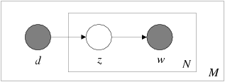
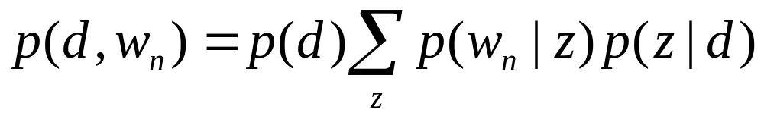
Topic Model / Probabilistic LSI
d is a localist representation of (trained) documents
LDA provides a distributed representation

Slide 24
LDA
Vocabulary of |V| words
Document is a collection of words from vocabulary.
    N words in document
    w = (w₁, ..., w_{N})
Latent topics
    random variable z, with values 1, ..., k
Like topic model, document is generated by sampling a topic from a mixture and then sampling a word from a mixture.
    But topic model assumes a fixed mixture of topics (multinomial distribution) for each document.
    LDA assumes a random mixture of topics (Dirichlet distribution) for each topic.

Slide 25
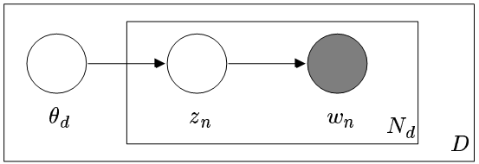

Generative Model
“Plates” indicate looping structure
    Outer plate replicated for each document
    Inner plate replicated for each word
    Same conditional distributions apply for each replicate
Document probability

Slide 26
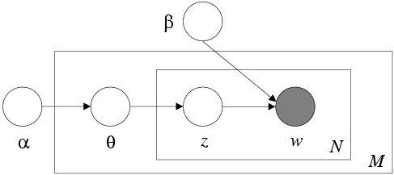
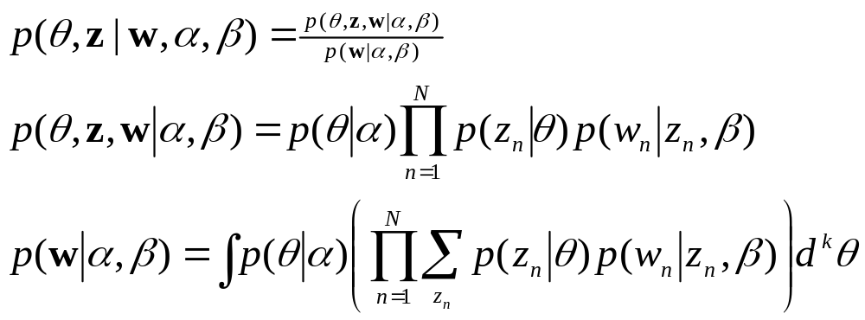
Inference

Slide 27
LDA PLATE NOTATION

Slide 28
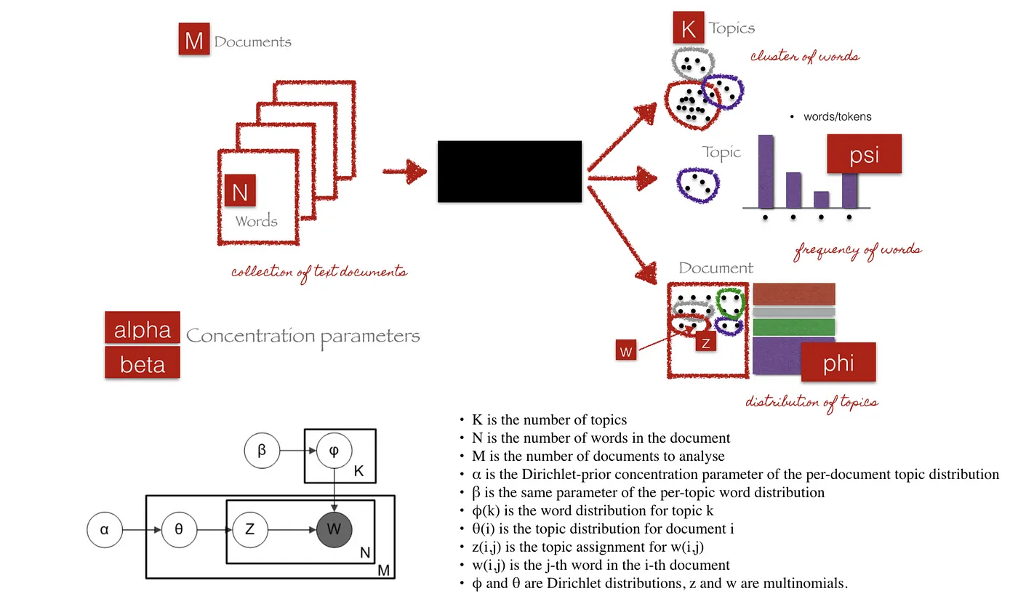

Slide 29
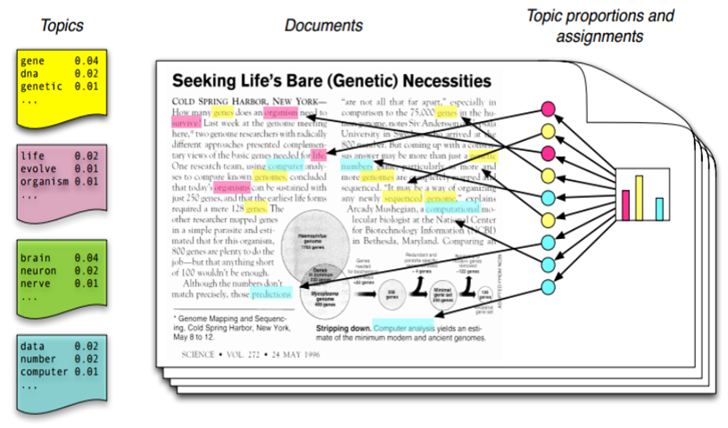

Slide 30
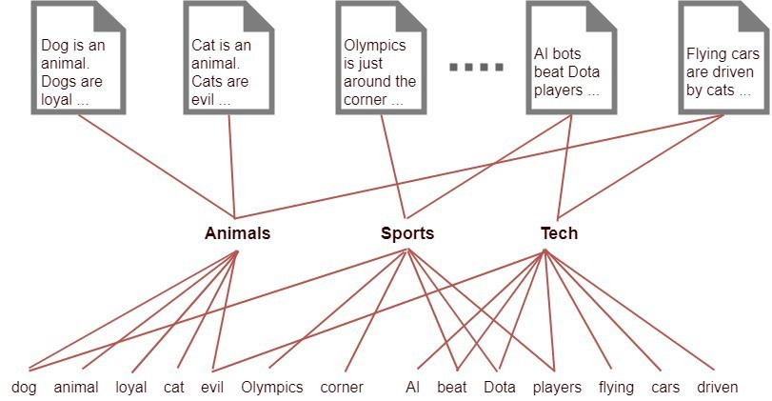

Slide 31
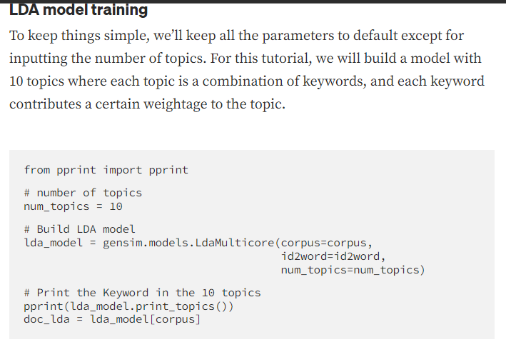

Slide 32
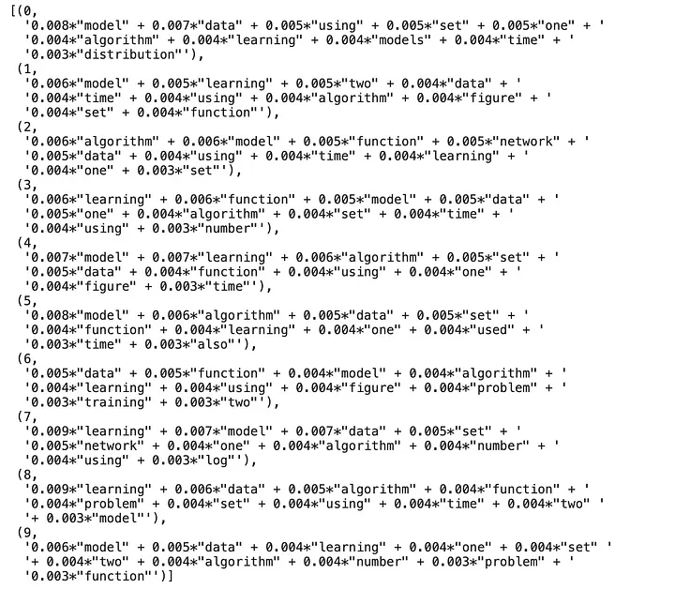
Topics

Slide 33
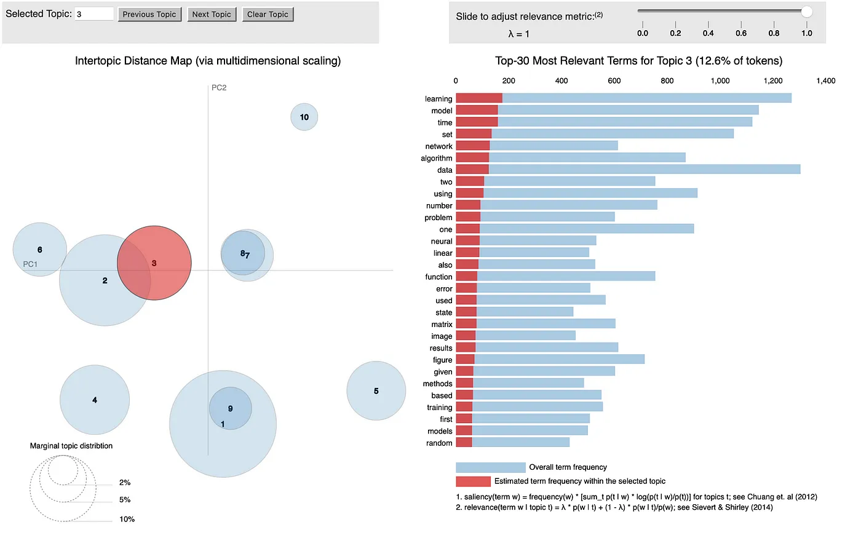

Slide 34
Summary: PLSA vs. LDA
LDA adds a Dirichlet distribution on top of PLSA to regularize the model
Estimation of LDA is more complicated than PLSA
LDA is a generative model, while PLSA isn’t
PLSA is more likely to over-fit the data than LDA
Which one to use?
  If you need generalization capacity, LDA
  If you want to mine topics from a collection, PLSA may be better (we want overfitting!)

Slide 35
Contextual Text Mining
Given collections of text with contextual information (meta-data)
Discover themes/subtopics/topics (interesting word clusters)
Compute variations of themes over contexts
Applications:
  Summarizing search results
  Federation of text information
  Opinion analysis
  Social network analysis
  Business intelligence
  ..

Slide 36


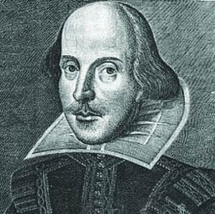



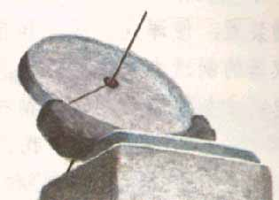



Context Features of Text (Meta-data)
Weblog Article
communities
Author
source
Time
Location
Author’s Occupation
Notes:
Compared with other kinds of data, Weblogs have some interesting special characteristics, which make it interesting to exploit for text mining.

Slide 37

Context = Partitioning of Text
papers written in 1998
1998
1999
Papers about Web
……
……
2005
2006
papers written by authors in US
WWW
SIGIR
ACL
KDD
SIGMOD

Slide 38
Themes/Topics
Theme θ₁
government 0.3
response 0.2..
[ Criticism of government response to the hurricane primarily consisted of criticism of its response to the approach of the storm and its aftermath, specifically in the delayed response ] to the [ flooding of New Orleans. … 80% of the 1.3 million residents of the greater New Orleans metropolitan area evacuated ] …[ Over seventy countries pledged monetary donations or other assistance]. …
donate 0.1
relief 0.05
help 0.02 ..
Theme θ₂
…
city 0.2
new 0.1
orleans 0.05 ..
Theme θ_{k}
Is 0.05
the 0.04
a 0.03 ..
Background B
Uses of themes:
  Summarize topics/subtopics
  Navigate in a document space
  Retrieve documents
  Segment documents
  …

Slide 39
View of Themes:
Context-Specific Version of Views
Context: After 1998 (Language models)
vector
TF-IDF
space
Okapi
Theme 2:
Feedback
Theme 1:
Retrieval Model
retrieve
LSI
vector
model
retrieval
feedback
weighting
Rocchio
relevance
judge
feedback
document
expansion
term
query
pseudo
query
language
mixture
model
model
smoothing
estimate
query
EM
generation
feedback
pseudo
Context: Before 1998 (Traditional models)

Slide 40
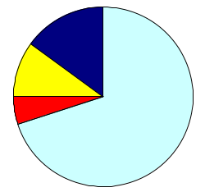
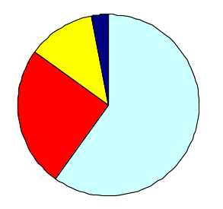
Coverage of Themes:
Distribution over Themes
Oil Price
Government
Response
Criticism of government response to the hurricane primarily consisted of criticism of its response to … The total shut-in oil production from the Gulf of Mexico … approximately 24% of the annual production and the shut-in gas production … Over seventy countries pledged monetary donations or other assistance. …
Aid and donation
Background
Context: Texas
Oil Price
Government
Response
Theme coverage can depend on context
Aid and donation
Background
Context: Louisiana

Slide 41
Sample Results
Comparative text mining
Spatiotemporal pattern mining
Sentiment summary
Event impact analysis
Temporal author-topic analysis

Slide 42
Comparing News Articles
Iraq War (30 articles) vs. Afghan War (26 articles)
The common theme indicates that “United Nations” is involved in both wars
 | Cluster 1 | Cluster 2 | Cluster 3
Common Theme | united 0.042 nations 0.04 … | killed 0.035 month 0.032 deaths 0.023 … | …
Iraq Theme | n 0.03 Weapons 0.024 Inspections 0.023 … | troops 0.016 hoon 0.015 sanches 0.012 … | …
Afghan Theme | Northern 0.04 alliance 0.04 kabul 0.03 taleban 0.025 aid 0.02 … | taleban 0.026 rumsfeld 0.02 hotel 0.012 front 0.011 … | …
Collection-specific themes indicate different roles of “United Nations” in the two wars

Slide 43
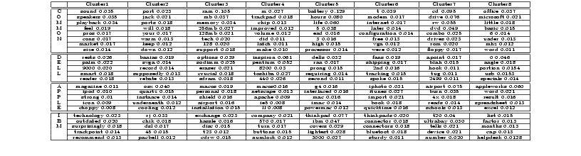
Comparing Laptop Reviews
Top words serve as “labels” for common themes
(e.g., [sound, speakers], [battery, hours], [cd,drive])
These word distributions can be used to segment text and
add hyperlinks between documents

Slide 44
Spatiotemporal Patterns in Blog Articles
Query= “Hurricane Katrina”
Topics in the results:
Spatiotemporal patterns

Slide 45
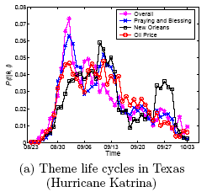
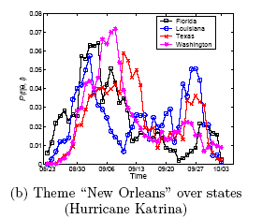
Theme Life Cycles for Hurricane Katrina
Oil Price
price 0.0772
oil 0.0643
gas 0.0454
increase 0.0210
product 0.0203
fuel 0.0188
company 0.0182
…
New Orleans
city 0.0634
orleans 0.0541
new 0.0342
louisiana 0.0235
flood 0.0227
evacuate 0.0211
storm 0.0177
…
Notes:
The upper figure is the life cycles for different themes in Texas. The red line refers to a theme with the top probability words such as price, oil, gas, increase, etc, from which we know that it is talking about “oil price”. The blue one, on the other hand, talks about events that happened in the city “new orleans”. In the upper figure, we can see that both themes were getting hot during the first two weeks, and became weaker around the mid September. The theme New Orleans got strong again around the last week of September while the other theme dropped monotonically.
In the bottom figure, which is the life cycles for the same theme “New Orleans” in different states. We observe that this theme reaches
the highest probability first in Florida and Louisiana, followed by Washington and Texas, consecutively. During early September, this theme drops significantly in Louisiana while still strong in other states. We suppose this is because of the evacuation in Louisiana. Surprisingly, around late September, a re-arising pattern can be observed in most states, which is most significant in Louisiana. Since this is the time period in which Hurricane Rita arrived, we guess that Hurricane Rita has an impact on the discussion of Hurricane Katrina. This is reasonable since people
are likely to mention the two hurricanes together or make comparisons. We can find more clues to this hypothesis from Hurricane Rita data set.

Slide 46
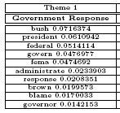
Theme Snapshots for Hurricane Katrina
Week2: The discussion moves towards the north and west
Week1: The theme is the strongest along the Gulf of Mexico
Week3: The theme distributes more uniformly over the states
Week4: The theme is again strong along the east coast and the Gulf of Mexico
Week5: The theme fades out in most states
Notes:
This slide shows the snapshot for theme ``Government Response'' over the first five weeks of Hurricane Katrina. The darker the color is, the hotter the discussion about this theme is. we observe that at the first week of Hurricane Katrina, the theme ``Government Response'‘ is the strongest in the southeast states, especially those along the Gulf of Mexico. In week 2, we can see the pattern that the theme is spreading towards the north and western states because the northern states are getting darker. In week 3, the theme is distributed even more uniformly, which means that it is spreading all over the states. However, in week 4, we observe that the theme converges to east states and southeast coast again. Interestingly, this week happens to overlap with the first week of Hurricane Rita, which may raise the public concern about government response again in those areas. In week 5, the theme becomes weak in most inland states and most of the remaining discussions are along the coasts.
Another interesting observation is that this theme is originally very strong in Louisiana (the one to the right of Texas, ), but dramatically weakened in Louisiana during week 2 and 3, and becomes strong again from the fourth week. Interestingly, Week 2 and 3 are consistent with the time of evacuation in Louisiana.

Slide 47
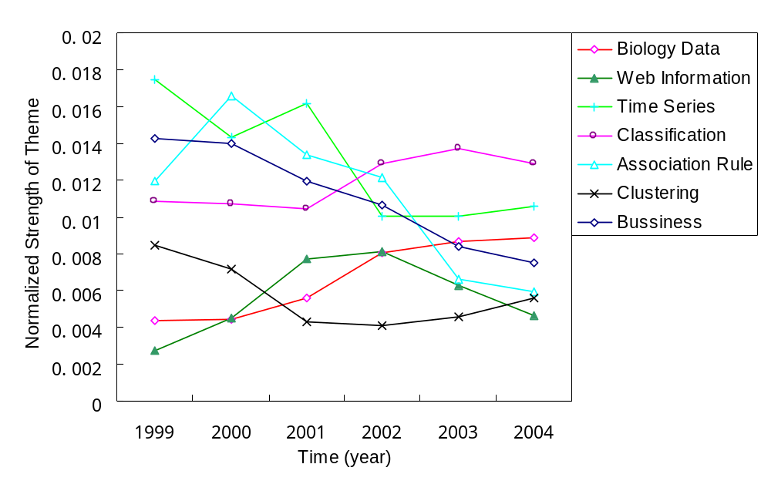
Theme Life Cycles: KDD
gene 0.0173
expressions 0.0096
probability 0.0081
microarray 0.0038
…
marketing 0.0087
customer 0.0086
model 0.0079
business 0.0048
…
rules 0.0142
association 0.0064
support 0.0053
…
Global Themes life cycles of KDD Abstracts

Slide 48
Theme Evolution Graph: KDD
1999
2000
2001
2002
2003
2004
T
web 0.009
classifica –tion 0.007
features0.006
topic 0.005
…
SVM 0.007
criteria 0.007
classifica – tion 0.006
linear 0.005
…
mixture 0.005
random 0.006
cluster 0.006
clustering 0.005
variables 0.005
…
topic 0.010
mixture 0.008
LDA 0.006
semantic
0.005
…
decision 0.006
tree 0.006
classifier 0.005
class 0.005
Bayes 0.005
…
…
Classifica
- tion 0.015
text 0.013
unlabeled 0.012
document 0.008
labeled 0.008
learning 0.007
…
Informa
- tion 0.012
web 0.010
social 0.008
retrieval 0.007
distance 0.005
networks 0.004
…
…
…
…

Slide 49
Blog Sentiment Summary
(query=“Da Vinci Code”)
 | Neutral | Positive | Negative
Facet 1: Movie | ... Ron Howards selection of Tom Hanks to play Robert Langdon. | Tom Hanks stars in the movie,who can be mad at that? | But the movie might get delayed, and even killed off if he loses.
 | Directed by: Ron Howard Writing credits: Akiva Goldsman ... | Tom Hanks, who is my favorite movie star act the leading role. | protesting ... will lose your faith by ... watching the movie.
 | After watching the movie I went online and some research on ... | Anybody is interested in it? | ... so sick of people making such a big deal about a FICTION book and movie.
Facet 2: Book | I remembered when i first read the book, I finished the book in two days. | Awesome book. | ... so sick of people making such a big deal about a FICTION book and movie.
 | I’m reading “Da Vinci Code” now. … | So still a good book to past time. | This controversy book cause lots conflict in west society.

Slide 50
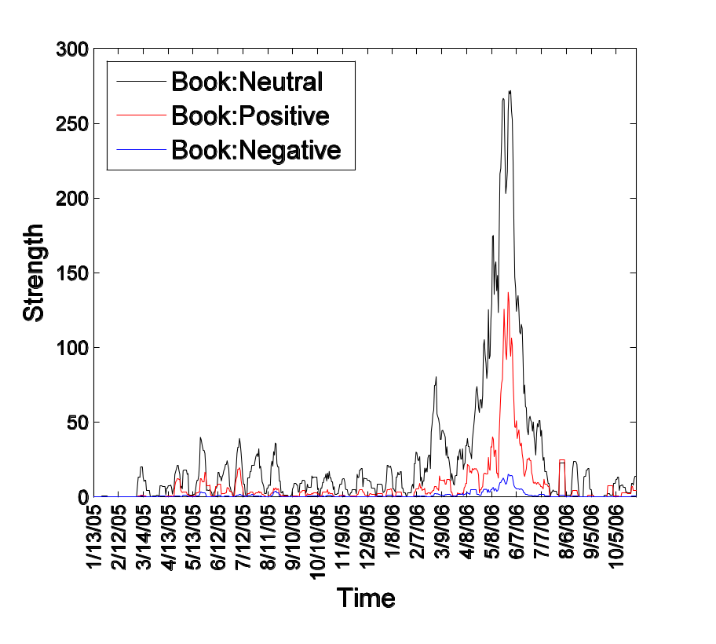
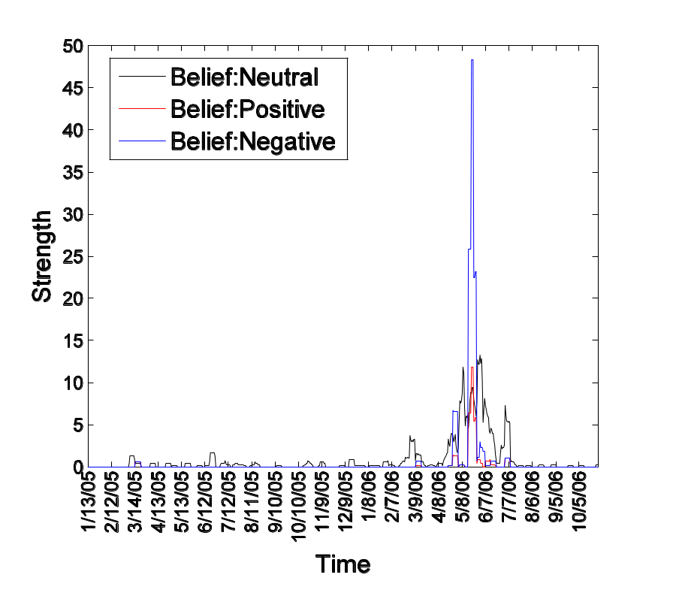
Results: Sentiment Dynamics
Facet: the book “ the da vinci code”. ( Bursts during the movie, Pos > Neg )
Facet: religious beliefs ( Bursts during the movie, Neg > Pos )

Slide 51
Event Impact Analysis: IR Research
xml 0.0678
email 0.0197
model 0.0191
collect 0.0187
judgment 0.0102
rank 0.0097
subtopic 0.0079
…
vector 0.0514
concept 0.0298
extend 0.0297
model 0.0291
space 0.0236
boolean 0.0151
function 0.0123
feedback 0.0077
…
Theme: retrieval models
SIGIR papers
term 0.1599
relevance 0.0752
weight 0.0660
feedback 0.0372
independence 0.0311
model 0.0310
frequent 0.0233
probabilistic 0.0188
document 0.0173
…
Publication of the paper “A language modeling approach to information retrieval”
1992
year
1998
Starting of the TREC conferences
model 0.1687
language 0.0753
estimate 0.0520
parameter 0.0281
distribution 0.0268
probable 0.0205
smooth 0.0198
markov 0.0137
likelihood 0.0059
…
probabilist 0.0778
model 0.0432
logic 0.0404
ir 0.0338
boolean 0.0281
algebra 0.0200
estimate 0.0119
weight 0.0111
…

Slide 52
Temporal-Author-Topic Analysis
close 0.0805
pattern 0.0720
sequential 0.0462
min_support 0.0353
threshold 0.0207
top-k 0.0176
fp-tree 0.0102
…
index 0.0440
graph 0.0343
web 0.0307
gspan 0.0273
substructure 0.0201
gindex 0.0164
bide 0.0115
xml 0.0109
…
project 0.0444
itemset 0.0433
intertransaction 0.0397
support 0.0264
associate 0.0258
frequent 0.0181
closet 0.0176
prefixspan 0.0170
…
Author
Jiawei Han
Author A
Global theme: frequent patterns
time
2000
Author B
pattern 0.1107
frequent 0.0406
frequent-pattern 0.039
sequential 0.0360
pattern-growth 0.0203
constraint 0.0184
push 0.0138
…
Rakesh Agrawal
research 0.0551
next 0.0308
transaction 0.0308
panel 0.0275
technical 0.0275
article 0.0258
revolution 0.0154
innovate 0.0154
…

Slide 53
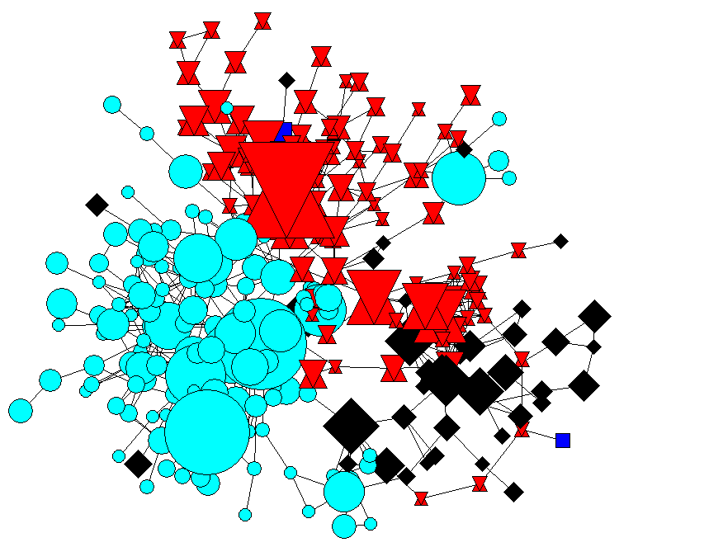
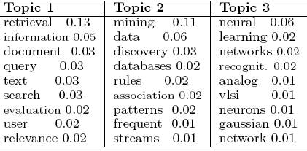
Modeling Topical Communities
(Mei et al. 08)
Community 1:
Information Retrieval
Community 2:
Data Mining
Community 3:
Machine Learning

Slide 54
Thank You!

